Slide 1

SHRI RAMSWAROOP MEMORIAL UNIVERSITY
SUBJECT : DATA ANALYTICS AND REPORTING
(UCS 3804)
SESSION : 2025 - 2026
TOPIC : TELCO CUSTOMER CHURN ANALYSIS
INNOVATIVE ASSIGNMENT
ANSH SINGH – Roll No : 202410101150053
PRINCE MISHRA – Roll No : 202410101150039
COURSE : B.TECH CSE (DS + AI) 32
SUBMITTED TO :
Ms. DEEPIKA TIWARI

Slide 2


Introduction
This project explores customer behavior in a telecom company to understand why customers stop using its services.
The dataset includes 7,043 records and 21 features covering customer demographics, service details, and churn information.

Slide 3



Project Objective
Analyze Customer Data
Identify Churn Factors
Drive Business Impact
Examine telecom customer profiles, service usage patterns, and behavioral indicators across multiple dimensions
Uncover the specific reasons and patterns that lead customers to terminate their service subscriptions
Deliver data-driven insights that enable the company to reduce churn rates and strengthen customer retention
By understanding the "why" behind customer departures, we can develop targeted strategies that address pain points and improve the overall customer experience.

Slide 4










Used Tools and Libraries
Python
Core programming language for data analysis and statistical computations
Pandas
Data handling, cleaning, transformation, and manipulation operations
Numpy
Numerical operations, array processing, and mathematical computations
Matplotlib
Data visualization and creating publication-quality charts and graphs
Seaborn
Advanced statistical visualization and beautiful analytical graphics
Development Platform: Google Colab – enabling collaborative cloud-based analysis with seamless library integration

Slide 5
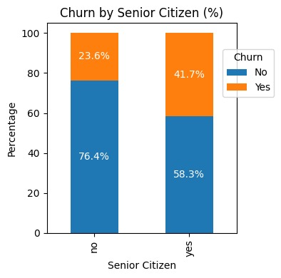
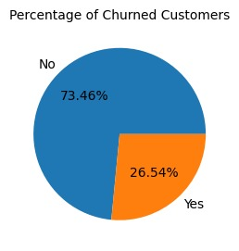
Key Findings & Results
26.54%
42%
60%
Overall Churn Rate
Senior Citizen Churn
Early Tenure Churn
More than 1 in 4 customers left the service
Customers leave within first 6 months
1.7× higher than general population
Contract Type Impact
Internet Service Analysis
Month-to-month: 43% churn
Fiber optic users: 44% churn
1-year contract: 11% churn
DSL users: 19% churn
2-year contract: 3% churn
Significant service quality gap

Slide 6




Project Achievements
Data Quality Assurance
Successfully cleaned the entire dataset, eliminating all missing values and duplicate records to ensure analytical accuracy
Data Transformation
Converted raw data into analyzable formats and created compelling visualizations using Python's powerful libraries
Pattern Identification
Discovered critical churn patterns and behavioral trends that form the foundation for predictive modeling initiatives

Slide 7

Strategic Business Insights
High-Risk Segments
Customers with short-term contracts and no support services show significantly elevated churn rates
Vulnerable Groups
Senior citizens and fiber-optic users require targeted retention strategies and enhanced support
Service Bundling Impact
Contract Strategy
Customers with comprehensive support services (Online Security, Tech Support) experience dramatically lower churn rates:
Promoting long-term contracts with loyalty incentives can deliver substantial improvements:
10–12% retention increase potential through strategic contract design
~15% churn vs. 43% for unbundled
services

Slide 8



Driving Customer Loyalty Through Data
Our comprehensive analysis reveals that tenure length, contract type, and additional service offerings are the primary drivers of customer loyalty and retention in the telecom industry.
Data Insights
Strategic Action
Business Results
Actionable patterns identified
Targeted retention programs
Improved profitability
By implementing these data-driven strategies—focusing on early customer engagement, promoting long-term contracts, bundling support services, and providing enhanced support to high-risk segments—the telecom provider can significantly improve customer retention and drive sustainable profitability growth.

Slide 9


